Slide 1
The Battle of Neighborhoods Searching hospital with good neighborhood in Oklahoma state
Applied data science capstone project
Payalben patel

Slide 2
STEPS PERFORMED :
Business Problem Selection
Data selection
Data Wrangling
Data Analysis
Machine Learning Algorithm
Result Analysis
Conclusion

Slide 3
Business Problem Selection
This project attempts to help you with the search for the hospital according to your need about the neighborhood in Oklahoma State.
For example, one might want to choose the area which has proximity to medical store, cafes, public transport etc. This project attempts cluster hospitals based on provided categories of neighborhood.
We can visualize those clusters on the map to get better idea of area.

Slide 4
Data Selection
I plan to use two datasets:
Oklahoma State Healthcare Facilities data downloaded from https://catalog.data.gov/dataset/oklahoma-health-care-facilities . I reduced the data set to focus on ‘Oklahoma’ City only to decrease the number of the call made to the Four-Square API.
This dataset has some column which will be of no use for our project so I have dopped it from the dataset. We will mainly use Latitude, Longitude, Address to query the FourSquare API and get the desire result.

Slide 5
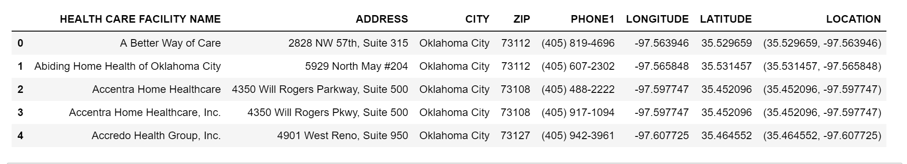
After some basic pre-processing the data is as below :

Slide 6
Data Wrangling
Data obtained from Data.Gov for Oklahoma HealthCare Facility has many columns but I concentrated on few columns only (City, Latitude, Longitude and Address).
By analyzing data on first hand I found out that it has many address repetition. So I have selected only unique address from the location data.
Also, I filtered the data for Oklahoma City to minimize the calls to Four square API and for better result.

Slide 7
Data Analysis
Oklahoma HealthCare Facility dataset has 149 unique city’s data and I filtered on a single city as to get better result namely Oklahoma.
First I have generated two map for Oklahoma State and Oklahoma City’s listed hospitals on the map.
After that I have generated the neighborhood venues for all the hospitals in the list and then I created seven different clusters based on the top four venue categories provided by Foursquare API data. I also explored top five venues in each cluster.

Slide 8
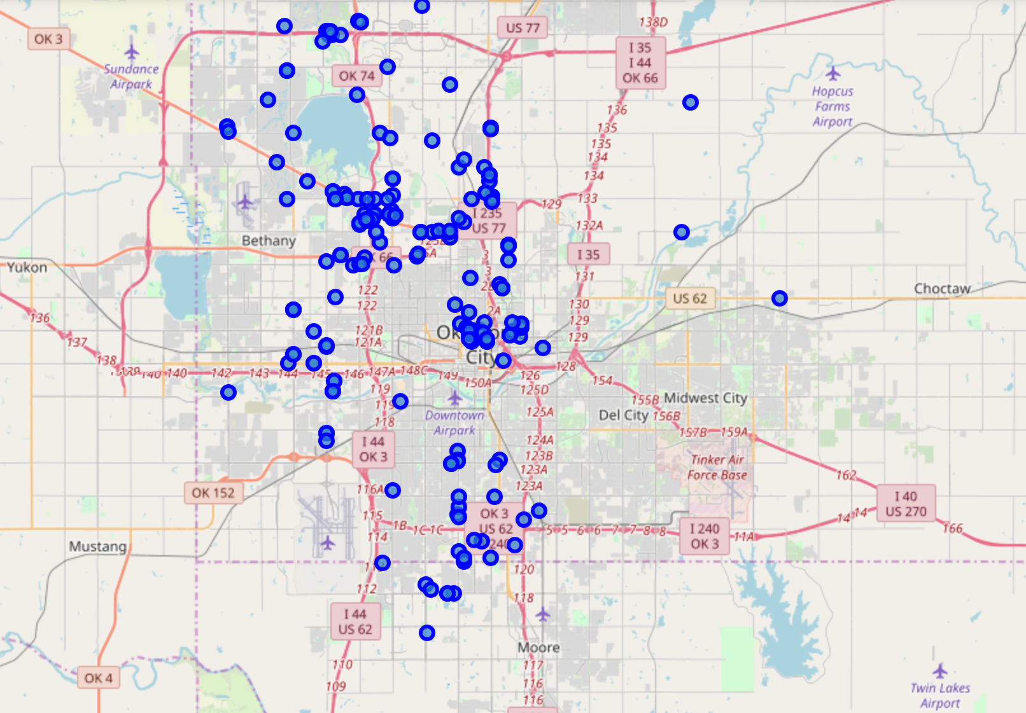
Oklahoma City map with all the listed hospitals

Slide 9
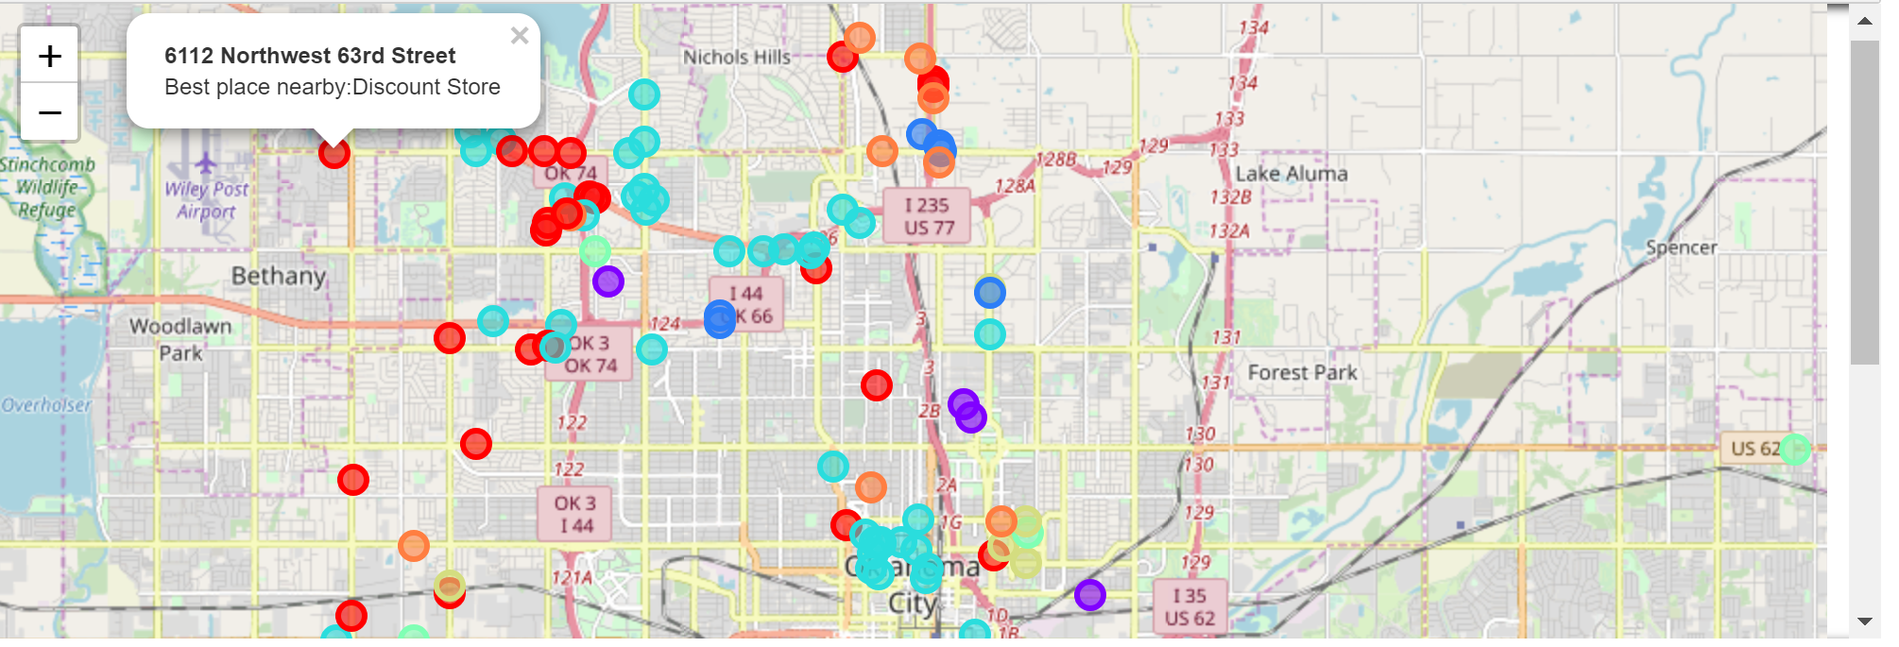
Oklahoma City Hospitals according to the neighborhood type cluster :

Slide 10
Machine Learning algorithm
I decide to use K means Clustering for the problem because after the data analysis it was obvious that we can categorize locations into different homogenous clusters based on the venue categories.
we will calculate the score for every category in each row as per their presence or absence in the area. The previous step will be sufficient to execute data mining technique I chose to accomplish this task(K mean clustering).
K means clustering will segment the data into groups where groups are similar among themselves but different from other groups in terms of occurrence of venue categories.

Slide 11
Results
I obtained 7 clusters from K means clustering executed in the previous step which are explained below:-
Cluster 0. Contains hospital with proximity to Medical Center, Park, Gym, Sandwich place etc.
Cluster 1. The cluster highlights all hospitals in the proximity to Steakhouse, Wings Joint, Mediterranean Restaurant etc.
Cluster 2. The cluster highlights all hospitals in the proximity to Fast Food Restaurant, Discount Store, American Restaurant, Grocery Store etc.
We can define other clusters same way.

Slide 12
Conclusion
As demonstrated in the Result section, we can effectively simplify the hospital search process for our customers by clustering the area based on the neighborhood venue categories and filtering the cluster to narrow down their search area.
Customers can then prefer to focus their hospital search by analyzing various trade offs. Those who are confused can efficiently compare various areas and choose the one which is most suitable for them.

Slide 13
THANKS

